Slide 1
SCC211 Operation System
(Processes)
大量考试题
Zhang Jinyu – zjy@bjtu.edu.cn
School of Computer and Information Technology
SD408

Slide 2
Overview
Process as a running program
Process Hierarchy
Scheduling
Types of system, processes and schedulers
Waiting for, and responding to, I/O
Dispatching a process
Process states
激活

Slide 3
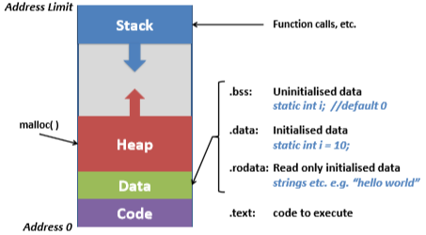
Program Address Space

Slide 4
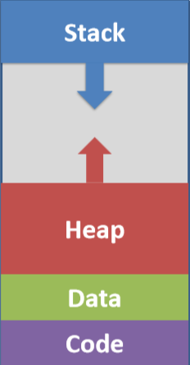
Processes
谁占据cpu(的寄存器),谁执行
A process is a loaded instance of a program
Defined by its context, including
Contents of CPU registers
Memory map (segments, pages, …)
Open files
On-going communication
Message queues
Signals, semaphores, …
Configured timers or alarms
Accounting info. / Resource usage
场景
不同机器：message
不同进程：semphore

Slide 5
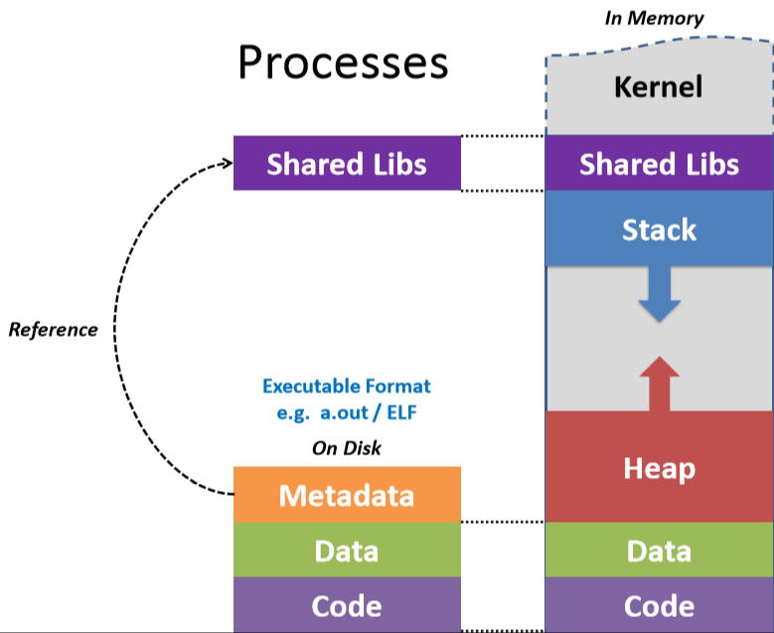
Processes
共享库
目录，访问数据需要知道地址

Slide 6
Types of System
Batch systems
Payroll processing, etc.
Real-Time systems
High quality multimedia to System (device, factory, …) management
Interactive systems
Desktops, etc. …responsiveness
用户机，桌面

Slide 7
Batch Systems
Non pre-emptive
Jobs run until blocked or complete
Scheduling Policies
First Come First Served
Shortest Job First
Base decision on expected run time until I/O or end
Use moving average to predict next expected run time AverageRunTime = LastRunTime * α + AverageRunTime * (1 – α)
非抢占，不允许打断
用时少优先
α Controls how much latest (single) run changes average

Slide 8
Input and Output
Natural scheduling point
Process becomes blocked waiting for I/O
Would otherwise ‘busy loop’ waiting for data
Schedule another process until I/O completes
自然调度点
进程在等待I/O时阻塞
否则“忙循环”会等待数据
调度另一个进程，直到I/O完成

Slide 9
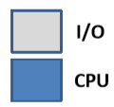
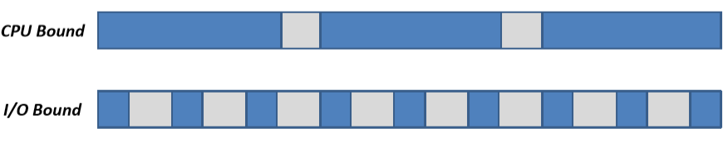
Characterizing Processes
CPU Bound
Process spends most of its time processing data
I/O Bound
Process spends most of its time waiting for data

Slide 10
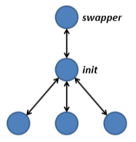
Process Hierarchy
Processes can spawn child processes
– Limit on number imposed by system
• Per process (for fairness)
• System wide(for system stability)
Each child has parent process
Ultimately responsible for resources used by child
限制子进程数
子进程共用父进程资源

Slide 11
Scheduling
考试题
中断CPU
Cost to every process switch
Interrupt latency (time taken to process interrupt)
Save current context (any process state)
Select next process
Load new context (recover any process state)
程序指针，数据栈
→ Scheduling overhead
对进程开销包括哪些？

Slide 12
Real-Time Processes
Soft Real-Time
Deadlines may be broken
e.g. Multimedia
Hard Real-Time
Deadlines critical
e.g. Embedded/ Control Systems
只要在ddl前完成就行
严格控制，例如导弹

Slide 13
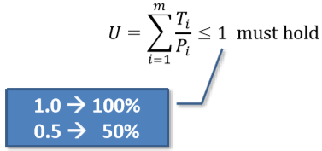
Real-Time Scheduling
event: timer，ddl
Driven by events/ deadlines
Periodic events …predictable
Aperiodic events …unpredictable
Must ensure work can be scheduled
Utilization (U) cannot be greater than 100% for
m periodic events of period P_{i}
Each requiring T_{i} seconds of CPU
timer,每一秒执行一次
周期

Slide 14
Real-Time Scheduling
Rate Monotonic
Static scheduling policy
Processes have fixed schedule based on priority
Schedule for worst case (unrolled schedule)
Worst possible sequence of events
Earliest Deadline First
Dynamic scheduling scheme
Each process has sequence of deadlines
Schedule process with closest deadline
优先级带来饥饿
取决于ddl
In both cases MUST ensure utilization doesn’t exceed 100%
-- typically involves some analysis of system

Slide 15
Interactive Systems
合作
任务/流程主动地将控制权交给调度器
对任务/流程中编码的调度器的显式调用
先发制人的
调度程序强制控制在常规区间
Multi-Tasking
Cooperative
Tasks/ processes actively yield control to scheduler
Explicit calls to scheduler coded within task/ process
Pre-emptive
Scheduler forcibly takes control at regular intervals
In either case I/O will bring decision forward
由人决定

Slide 16
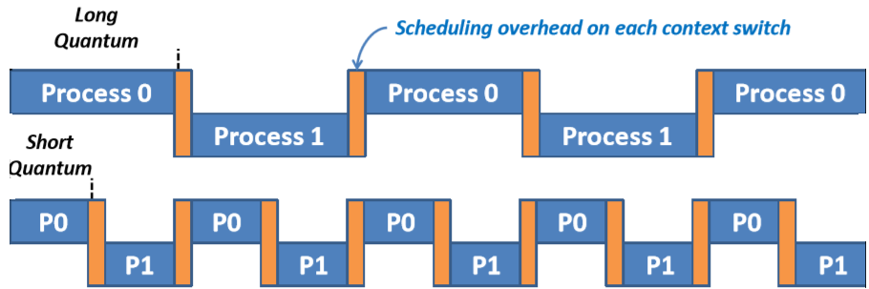
Pre-emptive Scheduling
Scheduler forces context switch at defined interval
Quantum determines how long processes run
Long: less interactive, fewer switches →more efficient
Short: more interactive, more switches →less efficient
开销小

Slide 17
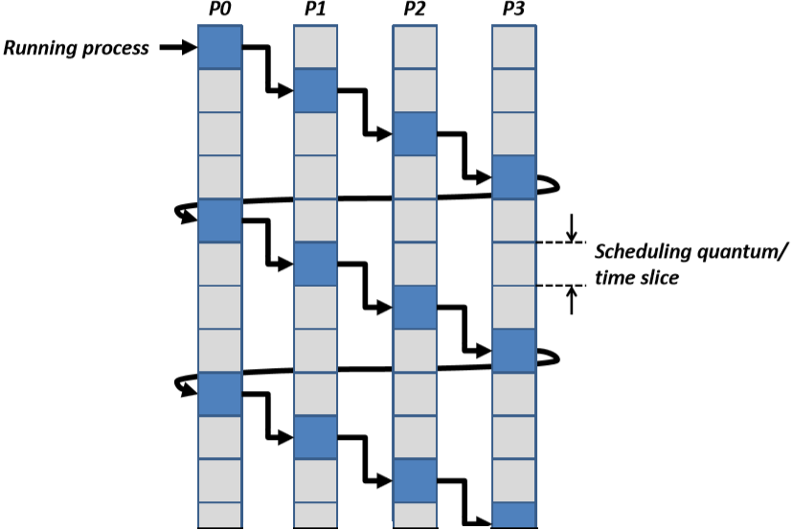
Round-Robin Scheduling
考试题
锦标赛/轮询

Slide 18
Priority Scheduling
Each process given a priority
High-priority processes selected over lower ones
Multi-priority queues
(typically) Round-Robin within each priority level
Tasks in higher priority queue take precedence

Slide 19
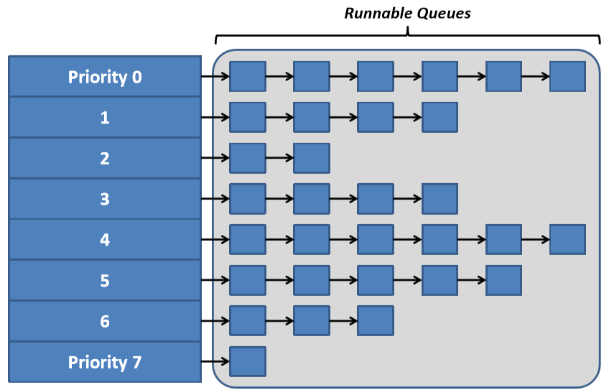
Multi-Priority Queues

Slide 20
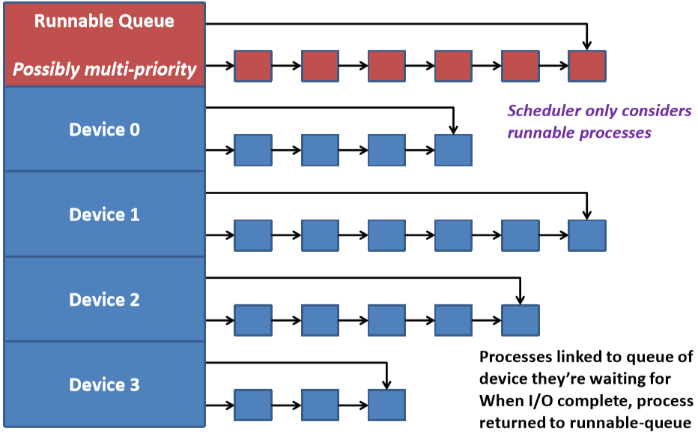
Device/wait queues

Slide 21
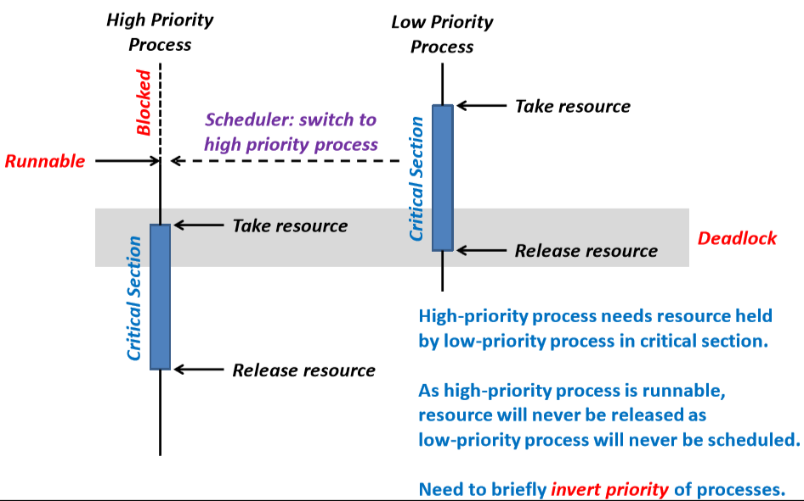
Priority Inversion
低优先级先来，将优先级提高，完成任务释放资源

Slide 22
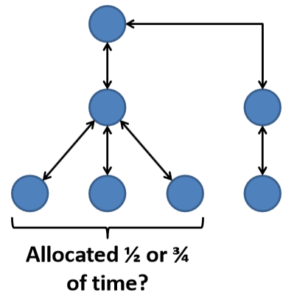
Fair Share Scheduling
Unfair to split resources equally
Should take account of process hierarchy
Allocation done higher up tree
Children share parent’s time and resource allocation

Slide 23
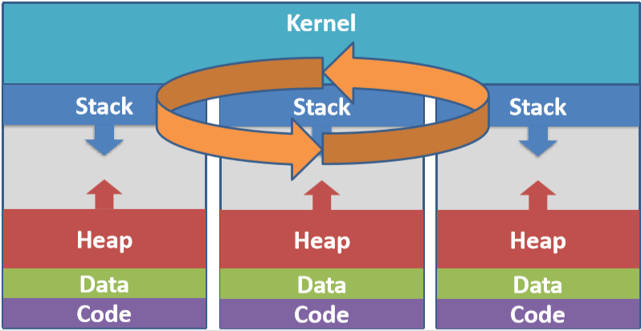
Multiple Processes
Each process has running state (context)
Instruction and Stack pointers, status flags, …

Slide 24
Basic Process Control Block (PCB)
Holds management information/ context, one per process
Process Management | Memory Management | File Management
Processor Registers | Address of Text Segment | Root directory
process state | Address of Data Segment | Working directory
Priority | Address of Stack Segment | Open file descriptors
Scheduling parameters | Address of Page Directory | Effective User ID
Process ID |  | Effective Group ID
Parent process
Process group
Signals
Start time
CPU time used
Total children’s CPU time
Next alarm
信号量

Slide 25
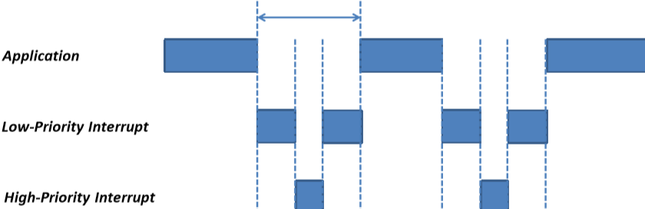
Revisiting Interrupts
Basis for pre-emptive scheduling
Interrupts may themselves be interrupted
Processing becomes nested
complicates code + timing
Typically group interrupts into priority levels (IRQL)
Defer processing of interrupts with lower Int. Request Level (IRQL)

Slide 26
NT interrupt request (IRQ) levels
IRQL
31 | High
30 | Power Failure
29 | Inter-processor signaling
28 | Clock
 | Device n
 | Device 1
2 | Dispatch/ Deferred Procedure Call (DPC) software interrupts
1 | Asynchronous Procedure Call level (APC) software interrupts
0 | Low (normal thread execution)
2^5
外设

Slide 27
Deferred Procedure Calls (DPCs)
Interrupt Service Routines (ISR) must be short
Huge number of interrupts per second
Simple dumb serial port can generate ~300,000 per sec
Failure to service IRQs can cause system failure
Interrupt Service Routine (ISR)
1. Does essential work (clears interrupt flags, etc.)
2. Schedules a worker process (a DPC) and exits

Slide 28
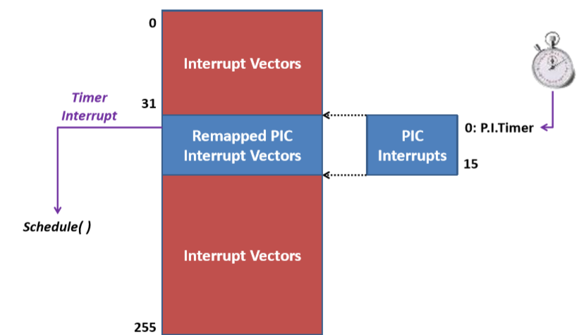
Invoking the Scheduler on x86
PIC程序中断控制器
硬件中断管不了
映射成一个

Slide 29
Invoking the Scheduler
#define PIC_OFFSET 32
#define PIC_LIMIT (PIC_OFFSET + 15)
void interrupt_handler(
struct cpu_registers regs, uint32_t irq, uint32_t
code, uint32_t eip, uint32_t cs, uint32_t flags, uint32_t
esp, uint32_t ss ) {
// Check for 8259 PIC event
if ( irq >= PIC_OFFSET && irq <= PIC_LIMIT ) {
irq -= PIC_OFFSET;
resetPICirq ( irq );
switch ( irq ) {
case 0: // Prog. Interval Timer
if ( running && --clock == 0 ) {
clock = SCHED_QUANTUM;
schedule ( &regs, &eip, &flags, &esp ); } break;
IRQ 请求水平 eip指令指针 esp栈指针
ss 页目录 cs段指针
中断号
旧的

Slide 30
Scheduling and Dispatching a Proceses
void schedule (
struct cpu_registers * regs, uint32_t * eip, uint32_t * eflags,
uint32_t * esp ) {
struct task * curtask;
curtask = &tasks[curpid]; // PCB Entry for current process
// Copy main registers ...
memcpy ( &curtask->regs, regs, sizeof(struct cpu_registers) );
curtask->eip = *eip; // Instruction Register
curtask->esp = *esp; // Stack Pointer
curtask->eflags = *eflags; // Status Register/ CPU Flags
curpid = ... ; // Select (Schedule) next process, and dispatch…
curtask = &tasks[curpid]; // PCB Entry for new process
memcpy ( regs, &curtask->regs, sizeof(struct cpu_registers) );
*eip = curtask->eip;
*esp = curtask->esp;
*eflags = curtask->eflags;
usrTSS->cr3 = curtask->pageDir; // Load process Page Tables }
当前运行
保护现场
新进程
恢复现场

Slide 31
Schedulers and Dispatchers
做/不做？
Long Term Scheduler
Given a new process, performs an admission test: should process be allowed to run (be added to ready queue)?
Medium Term/ high-level Scheduler
Handles course grained issues, including swapping (to disk), etc.
Sets process priorities, CPU affiliation, etc.
Short Term/ low-level Scheduler
Called every time slice
Decides which process picked next from run queues
Dispatcher
Given a (scheduled) task, performs a context switch to this task
内存不够
轮询

Slide 32
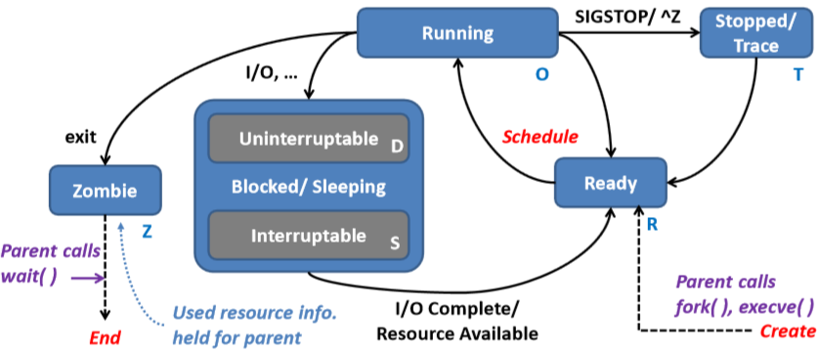
Typical Process States
Uninterruptable processes are in critical section
Likely needed for I/O completion
中止

Slide 33
Question？

